Slide 1


CS F212
Database Systems
BITS Pilani
Hyderabad Campus

Slide 2
Conceptual Database Design (ER Modeling) Ch.7
Content
ER Model
Steps in Database Design Process
Entities, Attributes, and Associations
ER Notations

Slide 3
Major Steps in Database Design Process
Step 1: Requirement analysis
Understanding the domain
Identifying the data to be stored
Identifying the constraints
Step 2: Conceptual Database design E-R modeling/UML
Step 3: Logical Database Design Designing tables and relationships
Step 4: Refinement of schema Step 5: Physical database design
Indexing
Clustering
Storage formats

Slide 4
ER Modeling
ER Model is a popular high-level (conceptual) data model.
It is an approach to designing Semantic Conceptual schema of a Database.
ER model allows us to describe the data involved in a real-world environment in terms of objects and their relationships, which are widely used in design of database.
ER model provides preliminary concepts or idea about the data representation which is later modified to achieve final detailed design.

Slide 5
ER Modeling
Important concepts/notions used in ER modeling are-
Entity is an object in real-world or some idea or concept which can be distinguished from other objects.
Ex.: person, school, class, department, weather,
salary, temperature etc.
Entity has independent existence.
Each entity belongs to an Entity type that defines the
structure.
Entity Set is a Collection of similar objects.
Dr. R.Gururaj

Slide 6
Concepts used in ER
Attribute: reflects a property of an object or entity. We have following types
of attributes.
Simple attribute
Composite attribute
Single valued attribute
Multi-valued attribute
Derived attribute
Stored attribute
Key : Is an Attribute of an entity type whose value can uniquely identify an
entity in a set.

Slide 7
Concepts used in ER
Relationship: The association between entities is
known as relationship.
Domain of an attribute: The set of possible values is
known as domain of an attribute

Slide 8
Notations used in ER
Notations used in ER modeling are shown below.
Entity Type
Weak Entity Type
Relationship Type
Identifying Relationship type
Attribute

Slide 9
Notations used in ER
Key Attribute
Multivalued Attribute
Composite Attribute
Derived Attribute

Slide 10
Notations used in ER
E₁
R _{E2}
Total Participation of E₁ in R
Cardinality ratio 1; N for E₁; E₂ in R
Structural Constraint (min, max) on Participation of E in R
1
N
E₂
E₁
R
(min, max)
R
E

Slide 11
Relationships in ER
Relationships
Manager
Manages
Employee
Manages
Employee
Manager
Degree of a Relationship
If there are two entity types involved it is a binary relationship type
Manages
Employee
Manager
If there are three entity types involved it is a ternary relationship type
Sales Assistant
Sells
Product
Unary relationships are also known as a recursive relationship
Manages
Customer
Employee
It is possible to have n-ary relationship (e.g. quaternary or unary)

Slide 12
Relationships in ER
Cardinality of a relationship
Relationships are rarely one-to-one.
For example, a manager usually manages more than one employee.
This is described by the cardinality of the relationship,
for which there are four possible categories.
1
is married to
1
One to one (1:1) relationship
Man
Women
1
Manages
m
One to many (1:M) relationship
Manager
Employee
m
Studies
1
Many to one (M:1) relationship
Student
Course
m
Teaches
n
Many to many (M:N) relationship
Lecturer
Student

Slide 13
Relationships in ER
Participation Constraint
If all the entities of an entity type are involved in the relationship then that entity type’s involvement said to be total in that relationship. In the below relationship if each employee is associated with at least one dept. Then the participation of EMP is total. Here, EMP works for DEPT.
If, only few entities of the set are involved the participation is partial.
E₁
R _{E2}
EMP
DEPT
Association Role:
Worker
Employer
*
1
Multiplicity
EMP
DEPT
Works_for
Association Name & Direction:
EMP
DEPT

Slide 14

Assume a scenario of Clubs (like- Dance Club, Music Club, Photography Club etc.) in an educational Institution, and we need to design a database. The description is follows.
Each Student has name, roll# (unique), address, contact (more than one contact
possible), and branch.
There exist clubs (for specialized activities like Dance, Music, Photography etc.),
each club has name (unique), start_date, Faculty-Incharge, Funds available. Clubs conduct events. Each event has start-date, end-date, description, budget.
Different clubs may conduct different events during same dates. But no single club will conduct more than one event at a given point of time i.e., a club cannot conduct more than one event with same start and end dates. One event is conducted by one club only. Note that Events will not have any IDs for.
Students can become cub members. One student can be member of more than one
club. Some may not have any membership.
Students can become club office bearers (even for clubs where they don’t have membership) in specific role like-secretary, treasures etc. One student can be office bearer for only one club. We capture info about present office bearers only

Slide 15
Summary
Various steps in database design process
What is ER modeling
Concepts and notations used in ER

Slide 16
Introduction to EER
Why EER
Some applications like –GIS, CAD/CAM, Telecommunication Have more complex requirements than normal database applications.
To meet the requirements additional modeling concepts were incorporated into Conceptual data modeling such as ER modeling.
The result is EER, stands for
Extended ER modeling or Enhanced ER modeling
The additional EER concepts are used to model applications more completely and more accurately.
EER includes some object-oriented concepts, such as inheritance
Dr. R.Gururaj

Slide 17
Additional concepts:
Subclasses/super classes
Specialization/generalization
Attribute and relationship Inheritance
These are fundamental to conceptual modeling.
Dr. R.Gururaj

Slide 18
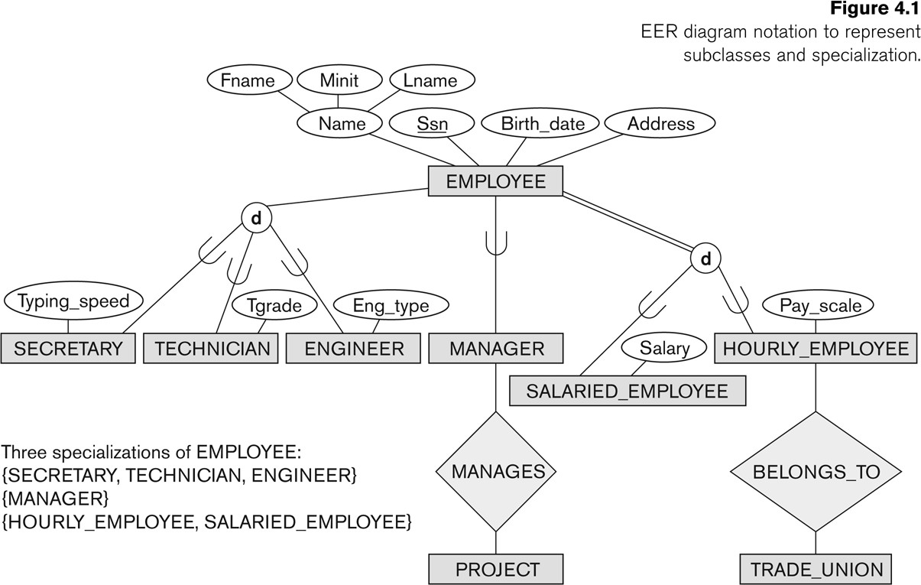
Subclasses in EER
Subclass of an Entity type
An entity type may have additional meaningful subgroupings of
its entities.
Dr. R.Gururaj

Slide 19
These are called superclass/subclass relationships
Note: An entity that is member of a subclass represents the same real-world entity as some member of the superclass:
The subclass member is the same entity in a distinct specific role
An entity cannot exist in the database merely by being a member of a subclass; it must also be a member of the superclass
A member of the superclass can be optionally included as a member of any number of its subclasses
Attribute Inheritance in Superclass / Subclass Relationships
Dr. R.Gururaj

Slide 20
Specialization in EER
Specialization is the process of defining a set of subclasses of a superclass.
Generalization is the reverse of the specialization process. Several classes with common features are generalized into a superclass. Original classes become its subclasses
Dr. R.Gururaj

Slide 21
Dr. R.Gururaj

Slide 22
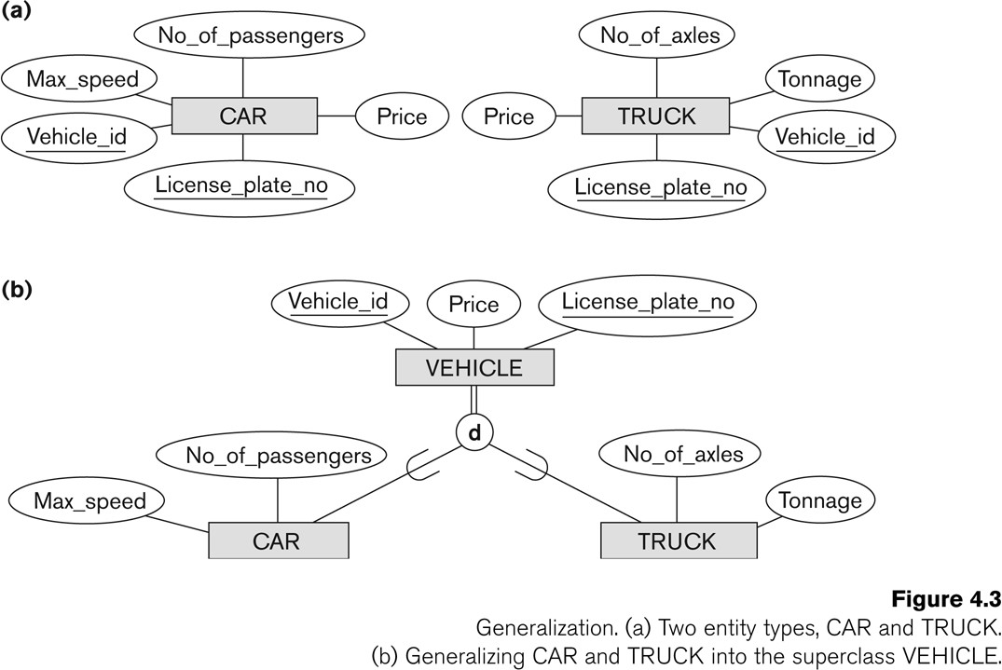
Dr. R.Gururaj

Slide 23
Constraints
Two basic constraints can apply to a specialization/generalization:
Disjointness Constraint:
Completeness Constraint:
Dr. R.Gururaj

Slide 24
Hence, we have four types of specialization/generalization:
Disjoint, total
Disjoint, partial
Overlapping, total
Overlapping, partial
Note: Generalization usually is total because the superclass is derived from the subclasses.
Dr. R.Gururaj

Slide 25
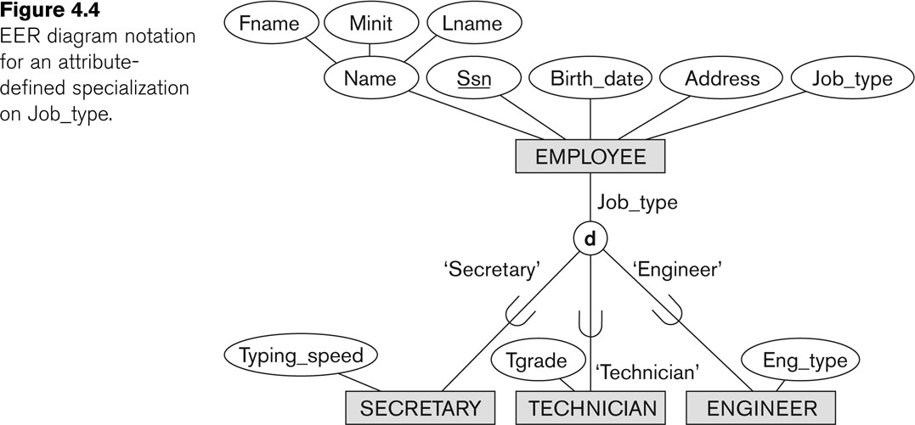
Example of disjoint partial Specialization
Dr. R.Gururaj

Slide 26
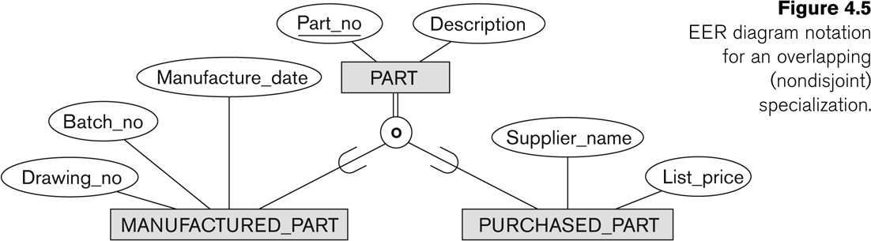
Example of overlapping total Specialization
Dr. R.Gururaj

Slide 27
Exercise Problem
Q. Assume that we need to capture the data about a Non-profit organization(NPO)
with following details/requirements.
The NPO depends on a number of different types of persons for its successful operations.
The NPO is interested in following attributes of a person- SSN (identifier), name, address (consists of house#/city/state/zip components), and telephone.
Three types of persons are of great interest to the NPO- employees, volunteers,
and donors.
Employees have only a date_hired attribute, volunteers have skill attribute, and donors have donor category as specific attribute.
Donors have a specific relationship (called Donates) with an item entity
type(assume suitable attributes for Item entity type including a key).
A donor must have donated one or more items, and an item may have no donors, or one or more donors.
There are persons other than employees, volunteers, and donors who are of interest to the NPO, so that a person need not belong to any of these three types/groups. On the other hand, at a given time a person may belong to two or more of the above groups.
Dr. R.Gururaj

Slide 28
We discussed:
What is EER
Subclasses/super classes
Specialization/generalization
Attribute and relationship Inheritance
Participation
Dr. R.Gururaj

